Slide 1
Football Players Analysis
Alaine Sarriegui

Slide 2
Introduction:
The data frame I am going to work with to analyse football players is Football Players Data (kaggle.com). The aim of this analysis is to explore the relation between the different qualities and abilities of the football players and the differences between nationalities.

Slide 3
Data cleaning:
Various data cleaning steps had to be done with the dataset in order for it to be useful:
Checking for null values and dropping them.
Dropping non-important columns.
Creating new columns for the analysis.
Re-indexing a column of the data frame.
Creating new data frames for the different parts of the analysis.
Concatening created new data frames together.

Slide 4
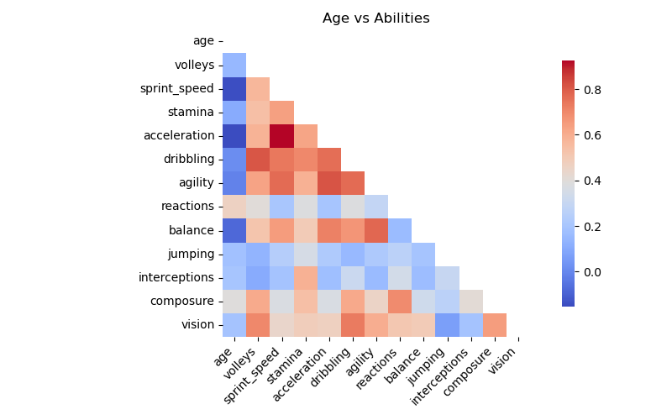
Relation between Age and different Abilities
Abilities like sprint speed, stamina, and acceleration show increasingly blue tones as they intersect with age, indicating a negative correlation. This suggests that these physical attributes tend to decline as players get older.
Attributes such as vision and composure turn redder where they meet age, suggesting that these abilities improve or remain stable as players age, likely reflecting increased experience and game understanding.

Slide 5
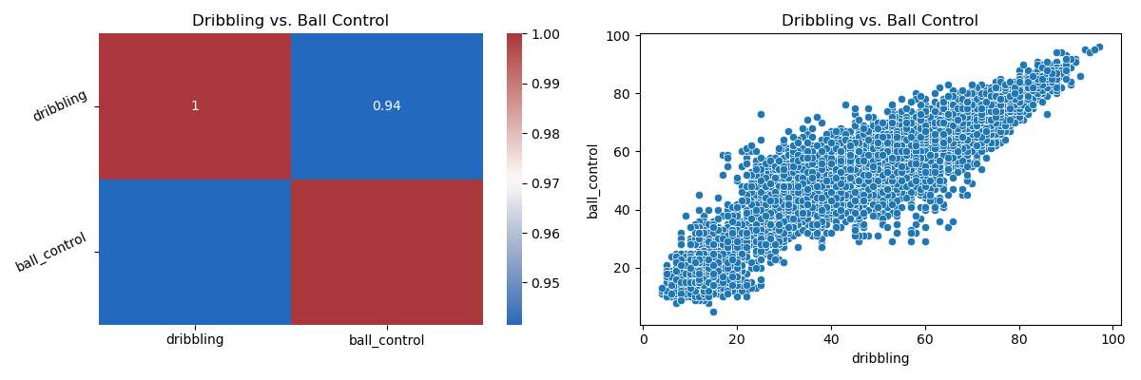
Relation between Dribbling and Ball Control
Clearly, dribbling and ball control are interdependent skills in football, where proficiency in one is likely to coincide with proficiency in the other.

Slide 6
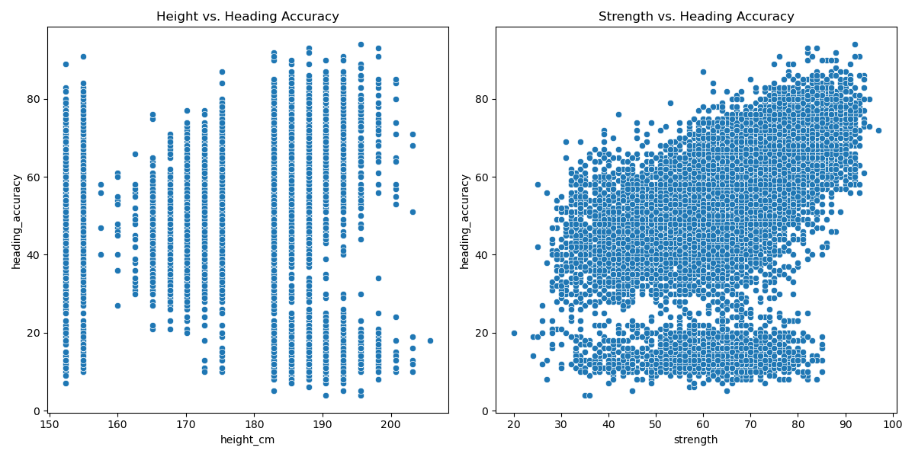
Relation between Heading Accuracy and Height and Strength
Height and strength attributes do not have a strong direct correlation with heading accuracy in football. This highlights the importance of considering multiple factors when evaluating or training players for aerial effectiveness, such as tactical knowledge, positional sense, and technical heading. skills.

Slide 7
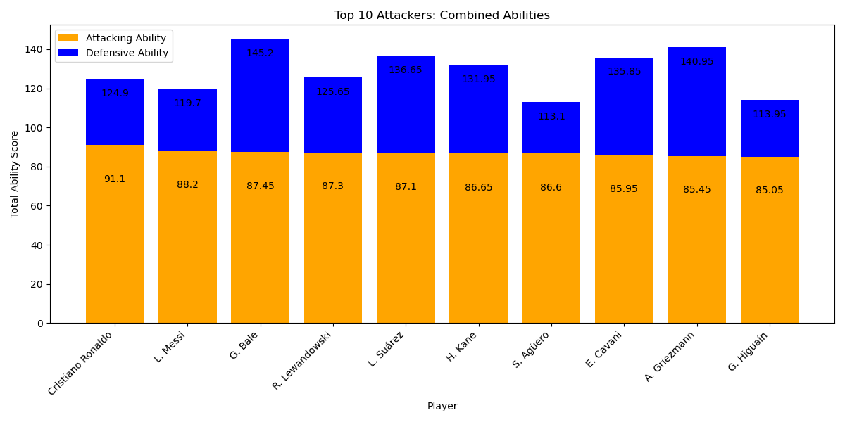
Top 10 Attackers
C. Ronaldo and L. Messi show significantly higher attacking scores compared to their defensive scores. This reflects their playing style and roles, which are very skewed towards offensive play.
G. Bale shows the highest combined scores, indicating his overall effectiveness and importance to his team in multiple facets of the game.
A. Griezmann exhibits a balanced distribution between both abilities, suggesting he is adaptable and can perform various roles on the field.

Slide 8
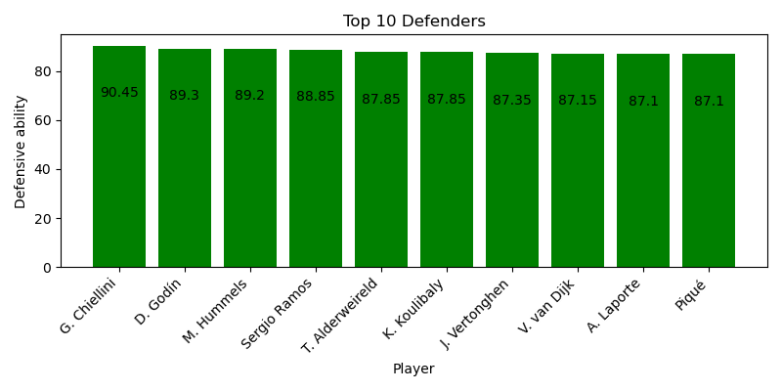
Top 10 Defenders

Slide 9
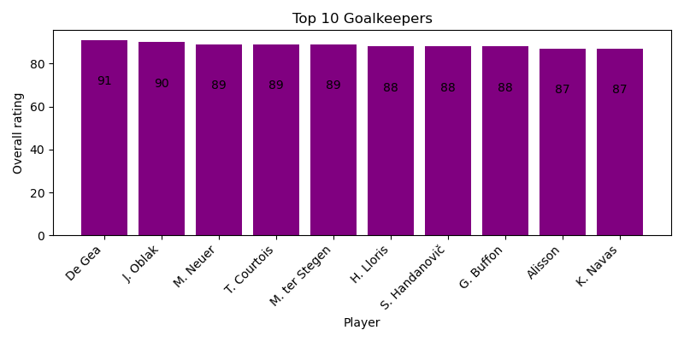
Top 10 Goalkeepers

Slide 10
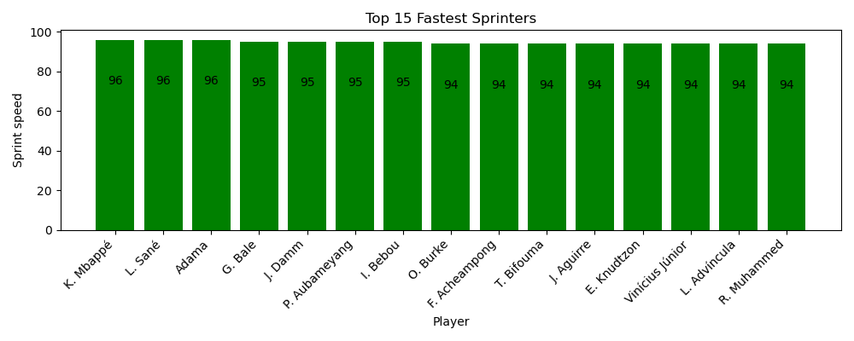
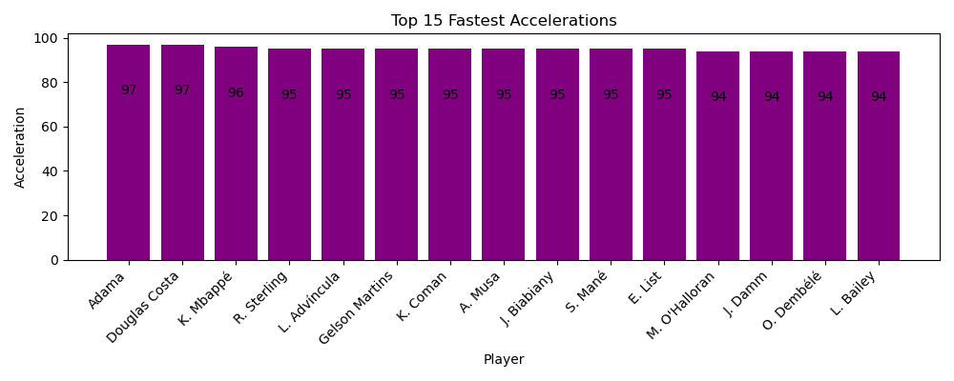
Top 15 Fastest Sprinters and Accelerations
Sprint speed scores are slightly lower and more uniform than acceleration, mostly clustering around 94 and 95. This suggests that while top speed is essential, its top performers are tightly packed in performance levels.
Some players are unique to one list, which can indicate specialization.
Other players like Adama and Mbapee appear in both lists, highlighting their exceptional abilities in both starting quickly and maintaining high speeds. This suggests these players have a significant role in counter-attacks or beating defenders.

Slide 11
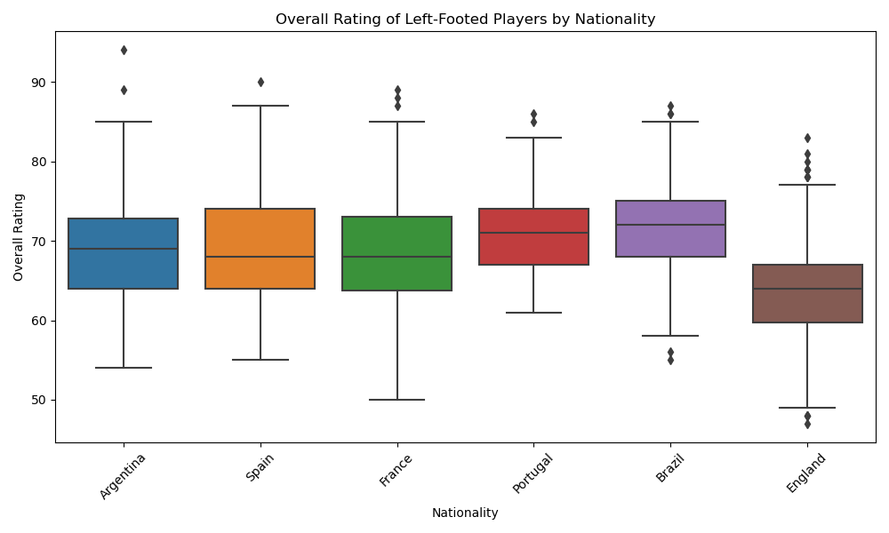
Overall Rating of Left-Footed Players by Nationality

Slide 12
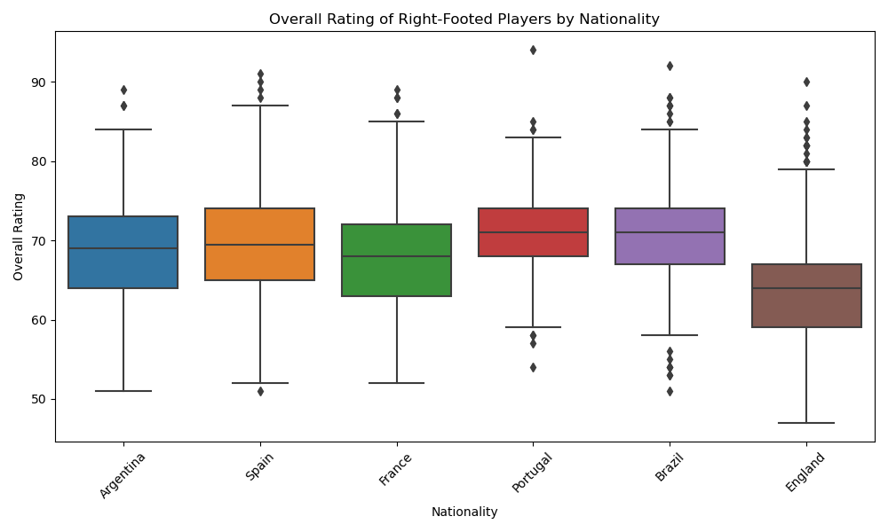
Overall Rating of Right-Footed Players by Nationality

Slide 13
Comparison between Left- and Right-Footed Players by Nationality
Right-footed players in countries like Spain, France, and Brazil tend to have similar medians to their left-footed counterparts, suggesting consistent player development regardless of foot preference.
Some countries like England show significant variability in player ratings regardless of foot preference, which might indicate a broader talent pool from which exceptional talents occasionally emerge.
The presence of outliers in both left- and right-footed charts for countries like Portugal and Brazil suggests that these countries produce a range of talents, including world-class players.

Slide 14
I am going to do further analysis and concentrate on Nationalities, Positions of the players on the field and Age Groups.

